Slide 1

Git And Github

Slide 2
Version Control
What is “version control”, and why should you care?
Version control is a system that records changes to a file or set of files over time so that you can recall specific versions later.
If you are a graphic or web designer and want to keep every version of an image or layout (which you would most certainly want to), a Version Control System (VCS) is a very wise thing to use.
It allows you to revert selected files back to a previous state, revert the entire project back to a previous state, compare changes over time, see who last modified something that might be causing a problem, who introduced an issue and when, and more.
Using a VCS also generally means that if you screw things up or lose files, you can easily recover. In addition, you get all this for very little overhead.

Slide 3
Version Control
Many people’s version-control method of choice is to copy files into another directory (perhaps a time-stamped directory, if they’re clever).
This approach is very common because it is so simple, but it is also incredibly error prone.
It is easy to forget which directory you’re in and accidentally write to the wrong file or copy over files you don’t mean to.
To deal with this issue, programmers long ago developed local VCSs that had a simple database that kept all the changes to files under revision control.

Slide 4
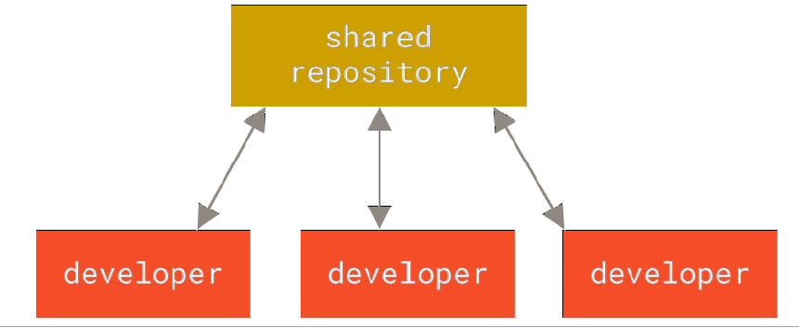
Centralized Version Control Systems
The major issue that people encounter is that they need to collaborate with developers on other systems.
To deal with this problem, Centralized Version Control Systems (CVCSs) were developed.
These systems (such as CVS, Subversion, and Perforce) have a single server that contains all the versioned files, and a number of clients that check out files from that central place.
For many years, this has been the standard for version control.

Slide 5
Centralized Version Control Systems
This setup offers many advantages, especially over local VCSs.
For example, everyone knows to a certain degree what everyone else on the project is doing. Administrators have fine-grained control over who can do what, and it’s far easier to administer a CVCS than it is to deal with local databases on every client.
However, this setup also has some serious downsides. The most obvious is the single point of failure that the centralized server represents. If that server goes down for an hour, then during that hour nobody can collaborate at all or save versioned changes to anything they’re working on. If the hard disk the central database is on becomes corrupted, and proper backups haven’t been kept, you lose absolutely everything — the entire history of the project except whatever single snapshots people happen to have on their local machines.

Slide 6
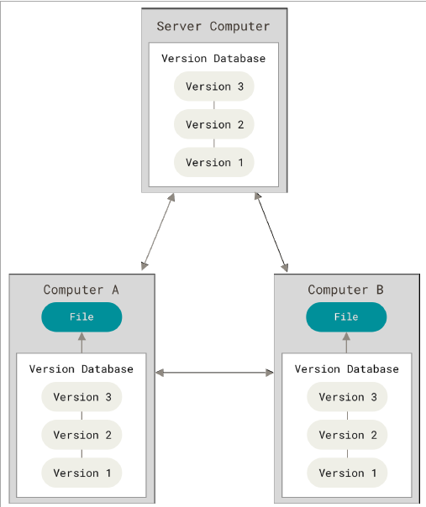
Distributed Version Control Systems
In a DVCS (such as Git, Mercurial, Bazaar or Darcs), clients don’t just check out the latest snapshot of the files;rather, they fully mirror the repository, including its full history.
Thus, if any server dies, and these systems were collaborating via that server, any of the client repositories can be copied back up to the server to restore it. Every clone is really a full backup of all the data.
Furthermore, many of these systems deal pretty well with having several remote repositories they can work with, so you can collaborate with different groups of people in different ways simultaneously within the same project.
This allows you to set up several types of workflows that aren’t possible in centralized systems, such as hierarchical models.

Slide 7
Git History
The Linux kernel is an open source software project of fairly large scope. For most of the lifetime of the Linux kernel maintenance (1991–2002), changes to the software were passed around as patches and archived files. In 2002, the Linux kernel project began using a proprietary DVCS called BitKeeper.
In 2005, the relationship between the community that developed the Linux kernel and the commercial company that developed BitKeeper broke down, and the tool’s free-of-charge status was revoked. This prompted the Linux development community (and in particular Linus Torvalds, the creator of Linux) to develop their own tool based on some of the lessons they learned while using BitKeeper. Some of the goals of the new system were as follows:
• Speed
• Simple design
• Strong support for non-linear development (thousands of parallel branches)
• Fully distributed
• Able to handle large projects like the Linux kernel efficiently (speed and data size)

Slide 8
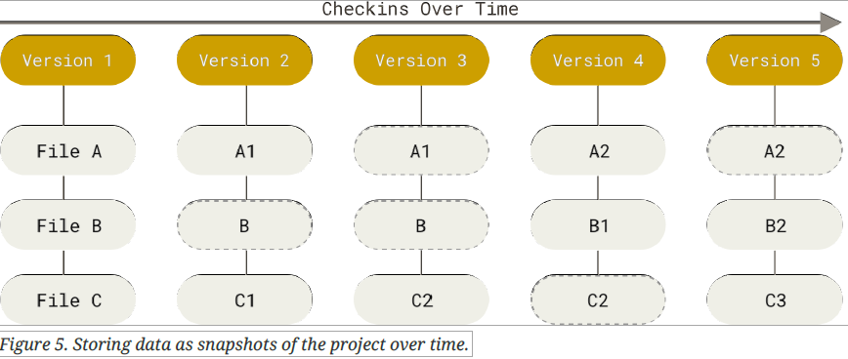
Git difference
The major difference between Git and any other VCS (Subversion and friends included) is the way Git thinks about its data.
Conceptually, most other systems store information as a list of file-based changes.
These other systems (CVS, Subversion, Perforce, Bazaar, and so on) think of the information they store as a set of files and the changes made to each file over time (this is commonly described as delta-based version control).
Git doesn’t think of or store its data this way. Instead, Git thinks of its data more like a series of snapshots of a miniature filesystem. With Git, every time you commit, or save the state of your project, Git basically takes a picture of what all your files look like at that moment and stores a reference to that snapshot. To be efficient, if files have not changed, Git doesn’t store the file again, just a link to the previous identical file it has already stored. Git thinks about its data more like a stream of snapshots.

Slide 9
Nearly Every Operation Is Local
Most operations in Git need only local files and resources to operate — generally no information is needed from another computer on your network.
If you’re used to a CVCS where most operations have that network latency overhead, this aspect of Git will make you think that the gods of speed have blessed Git with unworldly powers.
Because you have the entire history of the project right there on your local disk, most operations seem almost instantaneous.
This also means that there is very little you can’t do if you’re offline or off VPN. If you get on an airplane or a train and want to do a little work, you can commit happily (to your local copy, remember?) until you get to a network connection to upload
If you go home and can’t get your VPN client working properly, you can still work. In many other systems, doing so is either impossible or painful. In Perforce, for example, you can’t do much when you aren’t connected to the server; in Subversion and CVS, you can edit files, but you can’t commit changes to your database (because your database is offline). This may not seem like a huge deal, but you may be surprised what a big difference it can make.

Slide 10

Git Has Integrity
Everything in Git is checksummed before it is stored and is then referred to by that checksum. This means it’s impossible to change the contents of any file or directory without Git knowing about it.
This functionality is built into Git at the lowest levels and is integral to its philosophy. You can’t lose information in transit or get file corruption without Git being able to detect it.
The mechanism that Git uses for this checksumming is called a SHA-1 hash. This is a 40-character string composed of hexadecimal characters (0–9 and a–f) and calculated based on the contents of a file or directory structure in Git. A SHA-1 hash looks something like this:
You will see these hash values all over the place in Git because it uses them so much. In fact, Git stores everything in its database not by file name but by the hash value of its contents.

Slide 11
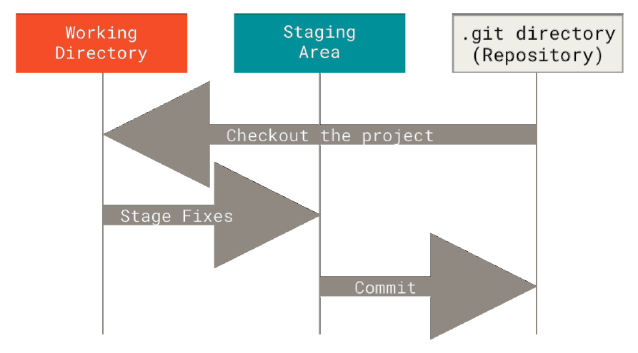
The Three States
Git has three main states that your files can reside in: modified, staged, and committed:
Modified means that you have changed the file but have not committed it to your database yet.
Staged means that you have marked a modified file in its current version to go into your next commit snapshot.
Committed means that the data is safely stored in your local database.
This leads us to the three main sections of a Git project: the working tree, the staging area, and the Git directory.

Slide 12
The Three States
The working directory is a single checkout of one version of the project. These files are pulled out of the compressed database in the Git directory and placed on disk for you to use or modify.
The staging area is a file, generally contained in your Git directory, that stores information about what will go into your next commit. Its technical name in Git parlance is the “index”, but the phrase “staging area” works just as well.
The Git directory is where Git stores the metadata and object database for your project. This is the most important part of Git, and it is what is copied when you clone a repository from another computer.

Slide 13
The basic Git workflow
1. You modify files in your working directory.
2. You selectively stage just those changes you want to be part of your next commit, which adds only those changes to the staging area.
3. You do a commit, which takes the files as they are in the staging area and stores that snapshot permanently to your Git directory.

Slide 14
command Line
There are a lot of different ways to use Git.
There are the original command-line tools, and there are many graphical user interfaces of varying capabilities.
We will be using Git on the command line.
For one, the command line is the only place you can run all Git commands — most of the GUIs implement only a partial subset of Git functionality for simplicity.
If you know how to run the command-line version, you can probably also figure out how to run the GUI version, while the opposite is not necessarily true.
All machines will have the command-line tools installed and available.

Slide 15
Installing Git
Installing on macOS
There are several ways to install Git on a Mac. The easiest is probably to install the Xcode Command Line Tools. On Mavericks (10.9) or above you can do this simply by trying to run git from the Terminal the very first time.
git –version
If you don’t have it installed already, it will prompt you to install it.
Installing on Windows
There are also a few ways to install Git on Windows. The most official build is available for download on the Git website. Just go to https://git-scm.com/download/win and the download will start automatically. Note that this is a project called Git for Windows, which is separate from Git

Slide 16
First-Time Git Setup
Git comes with a tool called git config that lets you get and set configuration variables that control all aspects of how Git looks and operates.
The first thing you should do when you install Git is to set your user name and email address.
This is important because every Git commit uses this information, and it’s immutably baked into the commits you start creating.
You need to do this only once if you pass the --global option, because then Git will always use that information for anything you do on that system
git config --global user.name "John Doe“
git config --global user.email johndoe@example.com

Slide 17
Getting a Git Repository
You typically obtain a Git repository in one of two ways:
1. You can take a local directory that is currently not under version control, and turn it into a Git repository, or
2. You can clone an existing Git repository from elsewhere.
In either case, you end up with a Git repository on your local machine, ready for work.

Slide 18
Initializing a Repository in an Existing Directory
If you have a project directory that is currently not under version control and you want to start controlling it with Git, you first need to go to that project’s directory and type this command in command line:
git init
This creates a new subdirectory named .git that contains all of your necessary repository files — a Git repository skeleton
If you want to start version-controlling existing files (as opposed to an empty directory), you should probably begin tracking those files and do an initial commit. You can accomplish that with a few git add commands that specify the files you want to track, followed by a git commit:
git add *.c
git add LICENSE
git commit -m 'Initial project version'

Slide 19
Cloning an Existing Repository
If you want to get a copy of an existing Git repository — for example, a project you’d like to contribute to — the command you need is git clone.
If you’re familiar with other VCS systems such as Subversion, you’ll notice that the command is "clone" and not "checkout".
This is an important distinction — instead of getting just a working copy, Git receives a full copy of nearly all data that the server has.
Every version of every file for the history of the project is pulled down by default when you run git clone.
In fact, if your server disk gets corrupted, you can often use nearly any of the clones on any client to set the server back to the state it was in when it was cloned
You clone a repository with git clone <url>.
git clone https://github.com/libgit2/libgit2
That creates a directory named libgit2, initializes a .git directory inside it, pulls down all the data for that repository, and checks out a working copy of the latest version. If you go into the new libgit2 directory that was just created, you’ll see the project files in there, ready to be worked on or used.

Slide 20
Recording Changes to the Repository
Typically, you’ll want to start making changes and committing snapshots of those changes into your repository each time the project reaches a state you want to record.
Remember that each file in your working directory can be in one of two states: tracked or untracked.
Tracked files are files that were in the last snapshot; they can be unmodified, modified, or staged. In short, tracked files are files that Git knows about.
Untracked files are everything else — any files in your working directory that were not in your last snapshot and are not in your staging area. When you first clone a repository, all of your files will be tracked and unmodified because Git just checked them out and you haven’t edited anything.
As you edit files, Git sees them as modified, because you’ve changed them since your last commit. As you work, you selectively stage these modified files and then commit all those staged changes, and the cycle repeats.

Slide 21
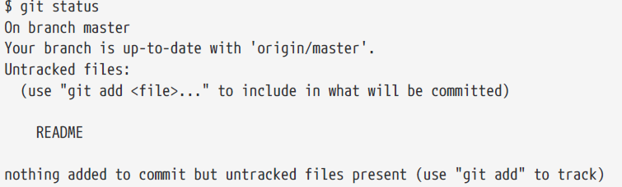
Checking the Status of Your Files
The main tool you use to determine which files are in which state is the git status command.
If you run this command directly after a clone, you should see something like this:
git status
On branch master
Your branch is up-to-date with 'origin/master'.
nothing to commit, working directory clean
This means you have a clean working directory; in other words, none of your tracked files are modified. Git also doesn’t see any untracked files, or they would be listed here. Finally, the command tells you which branch you’re on and informs you that it has not diverged from the same branch on the server. For now, that branch is always master.
Let’s say you add a new file to your project, a simple README file. If the file didn’t exist before, and you run git status, you see your untracked file like so:

Slide 22
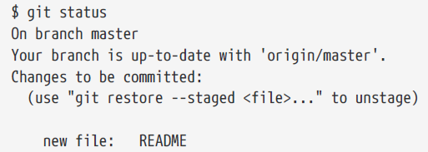
Tracking New Files
In order to begin tracking a new file, you use the command git add. To begin tracking the README file, you can run this:
git add README
If you run your status command again, you can see that your README file is now tracked and staged to be committed
If you commit at this point, the version of the file at the time you ran git add is what will be in the subsequent historical snapshot.

Slide 23
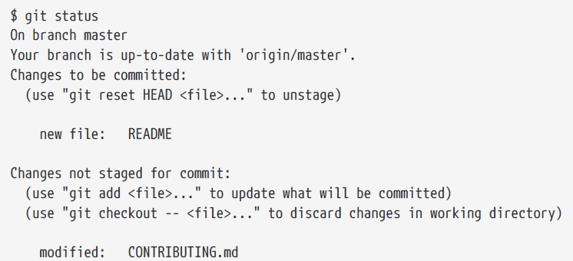
Staging Modified Files
Let’s change a file that was already tracked. If you change a previously tracked file called CONTRIBUTING.md and then run your git status command again, you get something that looks like this:
The CONTRIBUTING.md file appears under a section named “Changes not staged for commit” — which means that a file that is tracked has been modified in the working directory but not yet staged.
To stage it, you run the git add command. git add is a multipurpose command — you use it to begin tracking new files, to stage files, and to do other things.

Slide 24
Viewing Your Staged and Unstaged Changes
If the git status command is too vague for you — you want to know exactly what you changed, not just which files were changed — you can use the git diff command.
What have you changed but not yet staged? And what have you staged that you are about to commit? Although git status answers those questions very generally by listing the file names, git diff shows you the exact lines added and removed — the patch, as it were.
It’s important to note that git diff by itself doesn’t show all changes made since your last commit — only changes that are still unstaged. If you’ve staged all of your changes, git diff will give you no output.

Slide 25
Committing Your Changes
Now that your staging area is set up the way you want it, you can commit your changes.
Remember that anything that is still unstaged — any files you have created or modified that you haven’t run git add on since you edited them — won’t go into this commit.
They will stay as modified files on your disk.
In this case, let’s say that the last time you ran git status, you saw that everything was staged, so you’re ready to commit your changes. The simplest way to commit is to type git commit.
Alternatively, you can type your commit message inline with the commit command by specifying it after a -m flag, like this:
You can see that the commit has given you some output about itself: which branch you committed to (master), what SHA-1 checksum the commit has (463dc4f), how many files were changed, and statistics about lines added and removed in the commit.
Every time you perform a commit, you’re recording a snapshot of your project that you can revert to or compare to later.

Slide 26
Skipping the Staging Area
Although it can be amazingly useful for crafting commits exactly how you want them, the staging area is sometimes a bit more complex than you need in your workflow.
If you want to skip the staging area, Git provides a simple shortcut.
Adding the -a option to the git commit command makes Git automatically stage every file that is already tracked before doing the commit, letting you skip the git add part:
git commit -a -m 'Add new benchmarks'

Slide 27
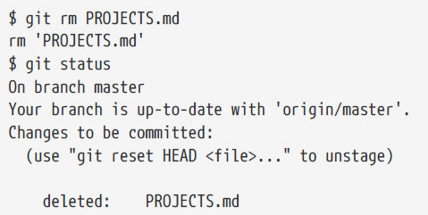
Removing Files
To remove a file from Git, you have to remove it from your tracked files (more accurately, remove it from your staging area) and then commit.
The git rm command does that, and also removes the file from your working directory so you don’t see it as an untracked file the next time around.
If you modified the file or had already added it to the staging area, you must force the removal with the -f option. This is a safety feature to prevent accidental removal of data that hasn’t yet been recorded in a snapshot and that can’t be recovered from Git.

Slide 28
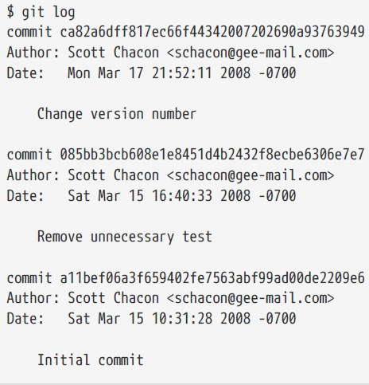
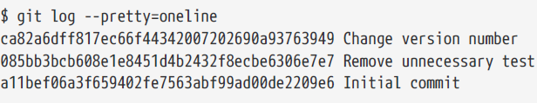
Viewing the Commit History
After you have created several commits, or if you have cloned a repository with an existing commit history, you’ll probably want to look back to see what has happened.
The most basic and powerful tool to do this is the git log command.
By default, with no arguments, git log lists the commits made in that repository in reverse chronological order; that is, the most recent commits show up first.
As you can see, this command lists each commit with its SHA-1 checksum, the author’s name and email, the date written, and the commit message.
One of the more helpful options is -p or --patch, which shows the difference (the patch output) introduced in each commit git log –p
Another really useful option is --pretty. This option changes the log output to formats other than the default. The oneline option prints each commit on a single line, which is useful if you’re looking at a lot of commits.

Slide 29
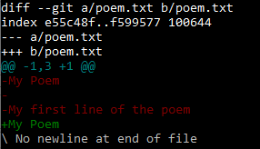
Viewing the COMMIT DIFFERENCES
We can use git diff CHEKSUM1 CHEKSUM2 to view what has changed between 2 different commits.
git diff 5c928362cb8a1ce42f8190377c7b3630715d1ece ecfa4b7fda5f8d8955b8f983aa7bce215f00f584

Slide 30
Undoing Things
At any stage, you may want to undo something. Here, we’ll review a few basic tools for undoing changes that you’ve made.
Be careful, because you can’t always undo some of these undos. This is one of the few areas in Git where you may lose some work if you do it wrong.
One of the common undos takes place when you commit too early and possibly forget to add some files, or you mess up your commit message. If you want to redo that commit, make the additional changes you forgot, stage them, and commit again using the --amend option:
git commit –amend
It’s important to understand that when you’re amending your last commit, you’re not so much fixing it as replacing it entirely with a new, improved commit that pushes the old commit out of the way and puts the new commit in its place. Effectively, it’s as if the previous commit never happened, and it won’t show up in your repository history.
The obvious value to amending commits is to make minor improvements to your last commit, without cluttering your repository history with commit messages of the form, “Oops, forgot to add a file” or “Darn, fixing a typo in last commit”.

Slide 31
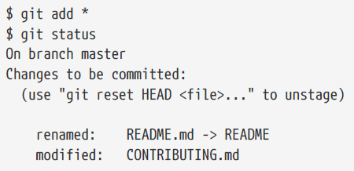
Unstaging a Staged File
For example, let’s say you’ve changed two files and want to commit them as two separate changes, but you accidentally type git add * and stage them both.
How can you unstage one of the two? The git status command reminds you:

Slide 32
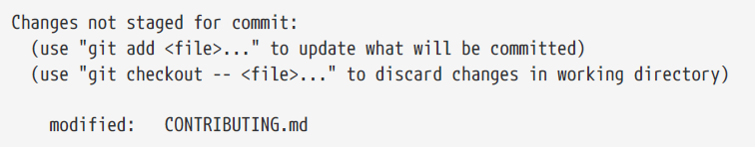
Unmodifying a Modified File
What if you realize that you don’t want to keep your changes to the CONTRIBUTING.md file? How can you easily unmodify it — revert it back to what it looked like when you last committed (or initially cloned, or however you got it into your working directory)? Luckily, git status tells you how to do that, too. In the last example output, the unstaged area looks like this:
git checkout -- CONTRIBUTING.md
Remember, anything that is committed in Git can almost always be recovered. Even commits that were on branches that were deleted or commits that were overwritten with an --amend commit can be recovered . However, anything you lose that was never committed is likely never to be seen again.

Slide 33
REVERTING A COMMIT
If you would like to revert to a previous commit use
git revert HEAD
HEAD - the snapshot of your last commit.

Slide 34
REVERTING A COMMIT
If you would like to revert to a specific previous commit use Checksum of that commit along with git reset--hard.
git reset --hard 3aece2d118a53e62d854dbcabaff05f236dbe345
Make sure to use this cautiously since this command will discard all the changes after that commit and bring your repository to snapshot of that specific commit.

Slide 35
Working with Remotes
To be able to collaborate on any Git project, you need to know how to manage your remote repositories.
Remote repositories are versions of your project that are hosted on the Internet or network somewhere.
You can have several of them, each of which generally is either read-only or read/write for you.
Collaborating with others involves managing these remote repositories and pushing and pulling data to and from them when you need to share work.
Managing remote repositories includes knowing how to add remote repositories, remove remotes that are no longer valid, manage various remote branches and define them as being tracked or not, and more
It is entirely possible that you can be working with a “remote” repository that is, in fact, on the same host you are. The word “remote” does not necessarily imply that the repository is somewhere else on the network or Internet, only that it is elsewhere

Slide 36

Showing Your Remotes
To see which remote servers you have configured, you can run the git remote command. It lists the shortnames of each remote handle you’ve specified. If you’ve cloned your repository, you should at least see origin — that is the default name Git gives to the server you cloned from.
You can also specify -v, which shows you the URLs that Git has stored for the shortname to be used when reading and writing to that remote:

Slide 37
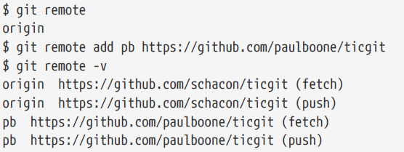
Adding Remote Repositories
We’ve mentioned and given some demonstrations of how the git clone command implicitly adds the origin remote for you. Here’s how to add a new remote explicitly.
To add a new remote Git repository as a shortname you can reference easily, run git remote add <shortname> <url>:

Slide 38
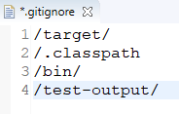
Ignoring Files
Often, you’ll have a class of files that you don’t want Git to automatically add or even show you as being untracked. These are generally automatically generated files such as log files or files produced by your build system.
In such cases, you can create a file listing patterns to match them named .gitignore. Here is an example .gitignore file:
The rules for the patterns you can put in the .gitignore file are as follows:
• Blank lines or lines starting with # are ignored.
• You can start patterns with a forward slash (/) to avoid recursivity.
• You can end patterns with a forward slash (/) to specify a directory.
• You can negate a pattern by starting it with an exclamation point (!).

